Slide 1
Bank Management System
BCA Project Presentation
Academic Year 2025-26

Slide 2
Synopsis
Objective: Simulate ATM transactions using Java.
Summary: Java Swing GUI + JDBC backend; modules include Login, Signup, Transactions.

Slide 3
Preamble – Introduction
ATM provides self-service for banking functions.
Simulates card entry, PIN validation, and financial operations.

Slide 4
Modules
Login & Signup: User authentication and registration.
Deposit: Add funds to account.
Withdraw & Fast Cash: Cash withdrawal with validation.
Balance Enquiry: Check current balance.
Mini Statement: View recent transactions.
PIN Change: Update security PIN.

Slide 5
Technical Description
Hardware: Standard PC, 4GB+ RAM.
Software: Java, NetBeans, MySQL, JDBC.

Slide 6
Flowchart
Start → Insert Card → Validate PIN → Choose Transaction → Process → End

Slide 7
Data Flow Diagram (DFD)
Shows data movement: User → ATM → Database → Result back to user.

Slide 8
Use Case Diagram
Customer performs: Login, Deposit, Withdraw, Balance Enquiry, PIN Change.

Slide 9
Sequence Diagram
User sends request → ATM validates → Processes → Responds → Updates

Slide 10
Class Diagram
Classes: Account, Transaction, ATM; Attributes: accountNo, balance, pin

Slide 11
Activity Diagram
Activities flow through swimlanes: User → ATM → Bank validation

Slide 12
Database Design
Tables: user_details, transaction_log
Relations: One-to-many between Account and Transactions

Slide 13
Screen Design and Coding
Swing UI: JFrame, JButton, JTextField
Code in Java classes per screen; JDBC for DB access

Slide 14
Conclusion
System replicates ATM workflow successfully using Java.
Achieves core banking functions with proper validation.

Slide 15
Learning During SIP
Java GUI development, Database interaction, System Design, UML Diagrams.

Slide 16
Bibliography
GeeksforGeeks, Oracle Docs, Kashipara, Visual Paradigm, Lucidchart, GitHub

Slide 17
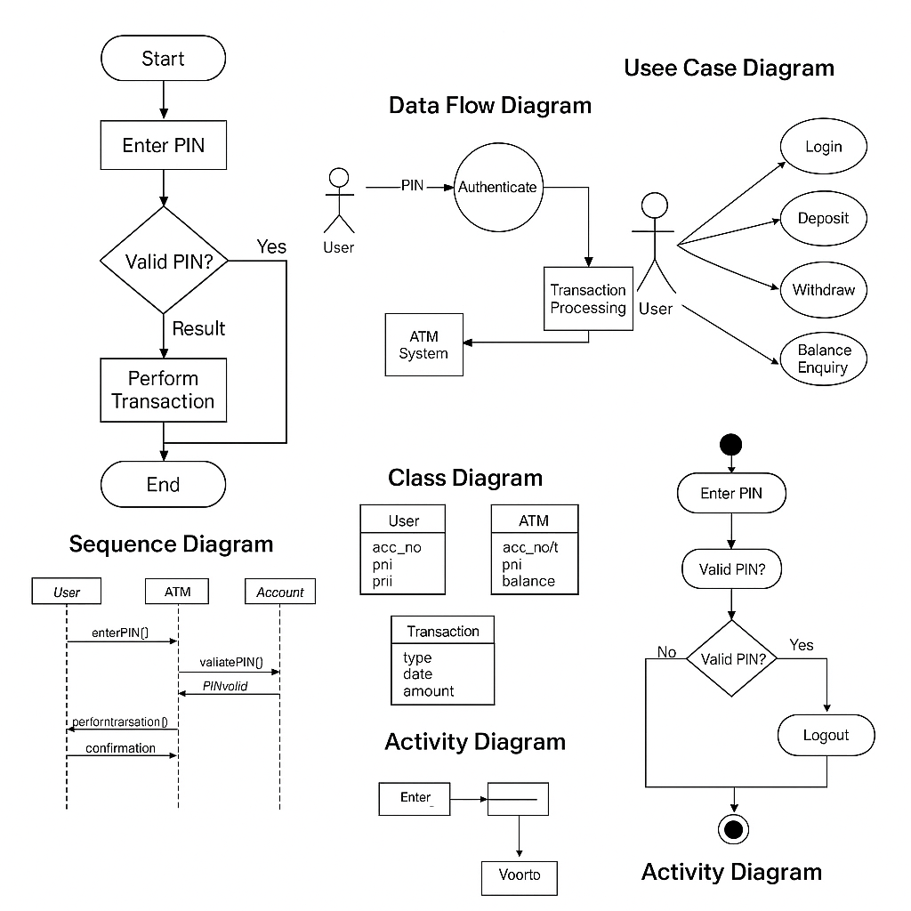
System Design Diagrams

